Slide 1
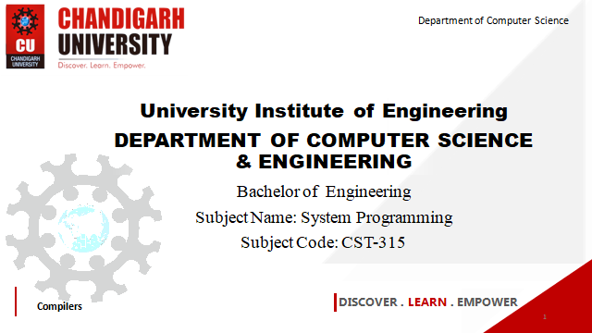

Department of Computer Science
University Institute of Engineering
DEPARTMENT OF COMPUTER SCIENCE & ENGINEERING
Bachelor of Engineering
Subject Name: System Programming
Subject Code: CST-281
Compilers
DISCOVER . LEARN . EMPOWER

Slide 2
Chapter-1.3 Macro
Department of computer Science
Macro & Macro Processor Introduction
Macro Definition & Call
Macro Expansion

Slide 3
What is Macro & Macro processor
Macro
A macro represents a commonly used group of statements in the source programming language
Macro represents a group of commonly used statements in the source programming language.
A Macro instruction is the notational convenience for the programmer. For every occurrence of macro the whole macro body or macro block of statements gets expanded in the main source code. Thus Macro instructions make writing code more convenient.
Macro Processor
• The macro processor replaces each macro instruction with the corresponding group of source language statement, this is called expanding macros
• The functions of a macro processor essentially involve the substitution of one group of characters or lines for another

Slide 4
Macro Processor
Salient features of Macro Processor:
Macro Processor replaces each macro instruction with the corresponding group of source language statements. This is known as the expansion of macros.
Using Macro instructions programmer can leave the mechanical details to be handled by the macro processor.
Macro Processor designs are not directly related to the computer architecture on which it runs.
Macro Processor involves definition, invocation, and expansion.

Slide 5
Macro Definition ,call & expansion
The MACRO statement identifies the beginning of a macro definition
The symbol in the label field is the name of the instruction
• The entries in the operand field identify the parameter of the macro instruction
• Each parameter begins with the character &
• The MEND assembler directive marks the end of the macro definition
• A macro invocation statement gives the name of the macro instruction being invoked and the arguments to be used in expanding the macro.

Slide 6
Macro Definition ,call & expansion (Contd..)
Macro Definition and Expansion:
Line Label Opcode Operand
5 COPY START 0
10 RDBUFF MACRO &INDEV, &BUFADR
15
. .
90
95 MEND
Line 10: RDBUFF (Read Buffer) in the Label part is the name of the Macro or definition of the Macro. &INDEV and &BUFADR are the parameters present in the Operand part. Each parameter begins with the character &.
Line 15 – Line 90: From Line 15 to Line 90 Macro Body is present. Macro directives are the statements that make up the body of the macro definition.
Line 95: MEND is the assembler directive that means the end of the macro definition.

Slide 7
Macro Invocation:
Line Label Opcode Operand
180 FIRST STL RETADR
190 CLOOP RDBUFF F1, BUFFER
15
. .
255 END FIRST
Line 190: RDBUFF is the Macro invocation or Macro Call that gives the name of the macro instruction being invoked and F1, BUFFER are the arguments to be used in expanding the macro. The statement that form the expansion of a macro are generated each time the macro is invoked.

Slide 8
References
John J Donovan Systems Programming Ebook Wordpress (pdflife.one)
[PDF] Systems Programming and Operating Systems by Dhamdhere - Free Download PDF (dlscrib.com)

Slide 9
THANK YOU

